Slide 1

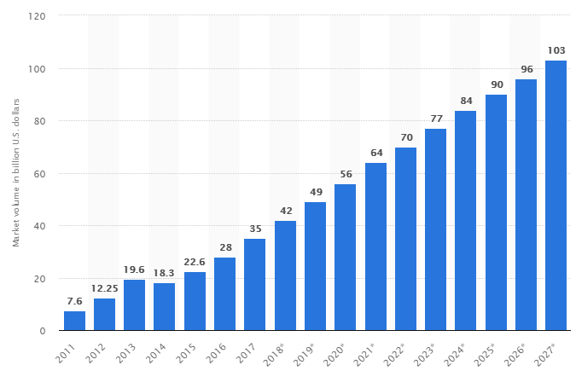
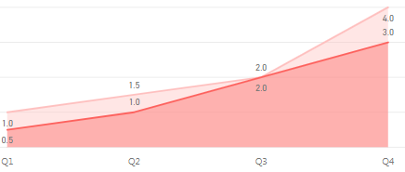
GS1 Canada Data Warehouse Project
1. Background and Purpose
4. Action Plan
According to Statista, the revenue of the Big Data industry will increase to 103 billion US dollars in size by 2027. With the current industry climate, GS1 Canada wants to build a “Data Warehouse”. Through successfully building D/W, GS1 Canada will obtain user experience about products, new revenue opportunities, and foundation to build “Big Data”.
# | Type | Issue | Role | Date
1 | Infra | Support technology (MongoDB/ETL tool/Business Intelligence tool) | System Architect | Jan ~
2 |  | Build GS1 Canada Data Marketplace (CMS) | System Architect | Feb ~
3 |  | Define prototype | System Architect | Feb
4 | Data | Define the report data and Visual Diagram | Data distributors (Sales/marketing/Finance/Executives … ) | Feb ~
5 | Training | Create Training module (Video/Mobile) with PowerApps | System Architect | Mar ~
6 | Guide | - Migration Procedure - Data Mapping Chart - Standard Operating Procedure - Report (Statistics) Service Request Form - Report Visualization Diagram and IO definition Form - User/Developer guide for GS1 Canada Data Marketplace | System Architect | Jan ~
7 | Project | Plan/Do Data Supply Pilot project | SA/DB/BI team | Mar ~ Apr
[Global Big Data market size]
49 B
103 B
2019
2027 year
2. Progress and Current situation
GS1 Canada:
- Understanding the importance of data utilization
- In the beginning stage of building Data Warehouse
- Preparing technical solutions with MongoDB (Storage)/Apach
NiFi(ETL)/Power BI (Business Intelligence)
- Defined the prototype for supplying data
5. Goal
6. Measures for Success
- Build D/W Tech Infrastructure
- Make Standard Operating Procedure (SOP)/Guides
- Raise participation rate by Quarter
[Weekly Avg Participate/Request count by a stakeholder]
- Is Infrastructure built
- Is GS1 Canada Data Marketplace built
- Is Standard Operating Procedure Prepared
- How many times stakeholders request BI Report work
- How many reports are in GS1 Data Marketplace
- What percent of BI report are used/reused
- How many stakeholders complete Training Module
3. Root-Cause Analysis:
[Comp. Business Intelligence Tools]
Quarter | Parcipate Count | Report Request
Q1 | 1 | 0.5
Q2 | 1.5 | 1
Q3 | 2 | 2
Q4 | 4 | 3
Type | Tableau | Power BI
Free Version | Public Version | Desktop Version
Cost | Creator: $70, Explorer: $35 on-premise/$42 cloud, Viewer: $12 on-premise/$15 cloud | Pro: $9.99, Premium: capacity pricing, charging per node per month
Good | Drill-down Visualization | Similar to Excel I/F, Included to Office 365 cloud Package
Bad | High cost for smaller Biz | Cannot share with Desktop
7. Purpose & Inquiry
- Each action plan needs another document in detail
E.G.: Data Supply Pilot project has different purpose,
duration from building Data Warehouse

Slide 2
























GS1 Canada Data Warehouse Project
System Diagram
Work-Process Diagram
GS1 Canada Data Warehouse
Suppliers | Inputs | Processes | Outputs | Consumers
- Data Distributors (Sales/marketing/Finance/Executives…) - Data Consumer - Data Governance - Technology team - BI team | - Data Definitions - Visual Diagrams - I/O Definitions - Service Requests | - Define Report - Request Report - Take request - Gather Data - Build Report - Response Report - Distribute Report - Reuse Report | - Data Migration - Statistics Reports - SharePoint Web pages - PowerApps Apps - Social media pages - Outlook emails | - Executives - Sales people - Marketers - Finance team - End-Users
Define
Gather
Share
Utilize
Power BI
Desktop
MongoDB
Power BI Cloud
Outlook
Apache NiFi
On-Premises
Gateway
Web / Mobile
BI Connector
SharePoint
PowerApps
Yammer
Start
Define/Visualize
Report
Request Service
Review
Migrate Data
OK
$$③$$
Distribute Report
Review
Build Report
Review
$$②$$
$$⑤$$
$$\text{⑧}$$
End
$$④$$
OK
OK
$$⑥$$
$$⑦$$
GS1 Canada Data Marketplace
$$①$$
- A GS1 Canada's Internal System that can be supplied and consumed GS1 Canada Statistics Reports.
- Reports should be reusable (Components) formats.
- Consumers can reuse reports, which were designed by other distributors
- Consumers can be distributors.
MS OFFICE 365
IBM DATA CENTER
Data Marketplace
Distribute to end-users
① Apache NiFi: Extract/Transform/Load data from RDBMS to MongoDB
② MongoDB BI Connector: Connect to MongoDB with Relational-Based Business Intelligence tool
③ Power BI Desktop: Define/Visualize/Publish report
④ Power BI Office 365 cloud: Request data with encrypted credentials in scheduled-time
⑤ On-premises data gateway: Decrypted credentials and send query data to MongoDB
⑥ MongoDB: Extract/Send data to On-premises data gateway, which response data to Office 365 cloud
⑦ SharePoint/PowerApps/Yammer: Share/Promote Statistic Reports in GS1 Canada Data Marketplace
⑧ Outlook/Web/Mobile: Unutilized Statistic Reports by end-users
Table 1
Chart 1
Matrix 1
Chart 1
Finance
Reuse
Supply
Table 2
Chart 2
Matrix 2
Re-Distribute
Matrix 1
Table N
Chart N
Matrix N
Table 2
Marketing
Sales
Internal (Office 365 SharePoint/PowerApps/Yammer)
External

Slide 3
GS1 Canada Data Warehouse Project
Cost for D/W
Storage
: Recommended solution
Type | On-Premises |  | Cloud
Edition | Community | Enterprise | MongoDB Atlas |  |  |  | mLab
Version | 4.0 Series | 4.0 Series | 3.4, 3.6, 4.0 |  |  |  | 3.6
Provider / OS | Windows Server 2012 R2 | Windows Server 2012 R2 | AWS | Google CloudPlatform | Azure | Trial | Community | AWS | Google CloudPlateform | Azure | Trial
RAM | 2 GB | 2 GB | 2 GB | 1.78 GB | 3.75 GB | Shared | Shared | 2 GB | 3.7 GB | 1.7 GB | Shared
Storage Capacity | 10 GB | 10 GB | 10 GB | 10 GB | 32 GB | 0.5 GB | 1 to 8 GB | 40 GB | 60 GB | 40 GB | 0.5 GB
Cost | Free | $1,000 per server yearly | $0.08/hr, $60/mo | $0.08/hr, $60/mo | $0.26/hr, $190/mo | Free | $15/mo | $ 180/mo | 360/mo | $200/mo | Free
Support | - | Security, Ops manager, In-Memory | Scalability, Security, Recovery, Performance |  |  | Scalability | Availability, Backup, Performance |  |  |  | Backup
Data Transfer | Depends on IBM cloud | Depends on IBM cloud | Same Region: $0.01/GB | In region: $0.01/GB | $0.087/GB | Free | Free | Free | Free | Free | Free
 |  |  | Different Region: $0.02/GB | Worldwide: $0.12/GB
 |  |  | Internet: $0.09/GB
Reference link | https://docs.mongodb.com/manual/administration/production-notes/ |  | https://www.mongodb.com/cloud/atlas/pricing |  |  |  | https://mlab.com/plans/pricing/
Software
Connectivity
Type | Data Migration | Data Visualization |  | Data Sharing
S/W | Apache NiFi | Power BI |  | Office 365
Edition | Open source | Desktop | Pro | SharePoint/PowerApps/Yammer
Cost | Free | Free | $9.99/User monthly
Type | Gateway On-Premise | BI Connectivity
 |  | MongoDB BI Connector | Simba MongoDB ODBC Driver
Cost | Free | Free | The number of installed processors
Description | Auto data refresh | Can use MongoDB in BI tool | MongoDB Cloud BI Connector
Human Resources
MongoDB Administrator, ETL/Power BI/Office 365 experts

Slide 4
GS1 Canada D/W Prototype Definition
1. Background and Purpose
5. Action Plan
GS1 Canada wants to build a “Data Warehouse” / “Big Data” system. For the first step of building D/W, the technology team need to define D/W prototype of Storage, ETL tool, and Visualization tool. GS1 Canada wants to finish it up to about 90% by the end of 2019 February. With the success of formalizing prototype, GS1 Canada can move to the next step for Data Supply Pilot project.
# | Type |  | Issue | Date
1 | Infrastructure |  | Support technology (MongoDB/ETL tool/Business Intelligence tool)
2 | Infrastructure |  | Build GS1 Canada Data Marketplace
3 | Demo | Define Data | Define the report data and Visual Diagram
4 |  | Gather Data | Migrate Data to MongoDB
5 |  | Define Data | Implement Statistics Reports with BI tool
6 |  | Share Data | Distribute Data with SharePoint/PowerApps/Yammer
7 | Guideline |  | - Migration Procedure - Data Mapping Chart - Standard Operating Procedure
2. Progress and Current situation
Technology team:
- Finishing researching basic technical solutions
(MongoDB (Storage)/Apache NiFi (ETL)/Power BI)
- Picking/testing Data Supply Scenarios
- Creating guides
6. Demo Scenario
Definition:
Visualization Diagram:
3. Goal
This report shows users who have logged in GS1 Canada services for specific date.
1. Data can be filtered by Date group, Service name
Filter1- Not logged in last 180/90/60/30/less than 30 days, Filter2- MyGS1, The Vault, TruesourceTM Dashboard …
2. This page shows a graph for total Login number by GS1 Canada Service Name
3. By filtering, table shows the users’ information.
Table includes FirstName, LastName,
CompanyName, GLN, SubscriberId and so on
Filter1
Filter2
- Tackle 90 % of technical solutions with the costs
(Storage, Software, and Connectivity)
- Make Standard Operating Procedure (SOP)/Guides
- Implement/publish/Share Power BI reports with the Demo Scenario
Not Logged in
Service Name
Graph1
Login Number
4. Measures for Success
Service Name
- Can data be stored in MongoDB
- Can data be migrated with Apache NiFi
- Can deltas be migrated in specific time periodically
- Can data be visualized in Power BI cloud
- Can data be refresh in specific time periodically
- Can reports be shared in SharePoint/PowerApps/Yammer
- Is Standard Operating Procedure Prepared
- Are the guides completed
Table1
7. Purpose & Inquiry
- Refer to demonstration document for more detail

Slide 5
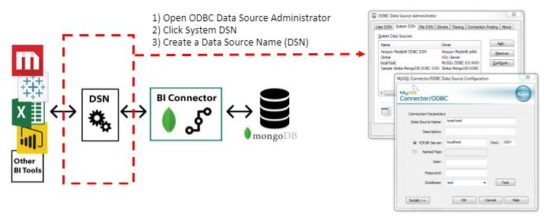
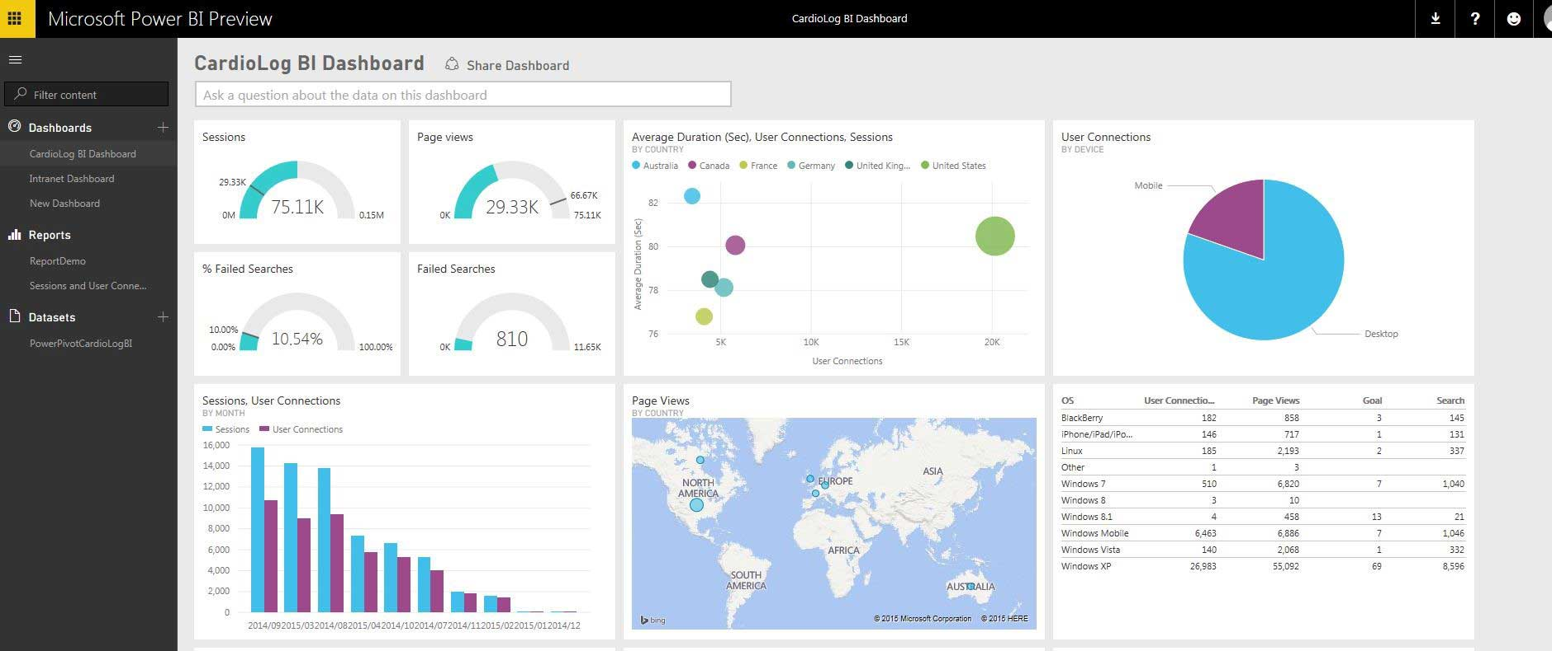
GS1 Canada D/W Prototype Demo
Scenario
IAM QA DB
in GS1 Canada
Migrate User Information from IAM QA DB to MongoDB (On-Premises/Cloud)
Apache NiFi
on Localhost Machine
Scenario:
1) User/Company/User_Role tables on GS1 Canada IAM DB
2) Migrate specific fields to one collection on MongoDB
3) View statistics page on Power BI cloud
Migration Strategy:
1) Define/Visualize Statistics Report
2) Design Schema Structure
3) Desert Strategy (Delete and Insert)
4) Delete all data on MongoDB
5) Extract/ Transform/Load specific fields data from Users table on IAM
6) Extract/ Transform/Load specific fields data from Company table on IAM
7) Extract/ Transform/Load specific fields data from Users Role table on IAM
8) Combine Users and User Role Information to one embedding Collection
9) Create Statistics page on Power BI Desktop using MongoDB BI Connector
10) Publish Statistics page on Power BI Cloud
11) Refresh report data in periodic time with Power BI Gateway
12) Share data with Office 365 SharePoint/PowerApps/Yammer
13) Monitor statistics data
MongoDB
on Local and Cloud
Power BI connector
- Publish/Share report on Power BI Cloud
- Refresh data in periodic time with Gateway

Slide 6
GS1 Canada D/W Prototype Demo
Operating Procedure
Start
Gather
End
Define
Share
Utilize
Start
Define/Visualize
Report
Schema Design
Design Report Page
Publish to
Power BI Cloud
Outlook/Social Media
(Facebook/LinkedIn…)
Request Service
Mapping
Implement Report Power BI Desktop
SharePoint/PowerApps/
Yammer
End
Review
Review
Review
Review
OK
OK
OK
Implement
Migrating
Review Quality

Slide 7

GS1 Canada D/W Prototype Demo
Start
Gather
End
Define
Share
Utilize
1. Data Definition & Visual Diagram
Define Data with Diagram/IO Definition
This page will be used to implement/publish a Statistics report on Power BI.
[Definition]
This report shows user list who have logged in GS1 Canada services for specific period.
1. Data can be filtered by Specific Date group, Service name
Filter1- Not logged in last 180/90/60/30/less than 30 days Filter2- MyGS1, The Vault, TruesourceTM Dashboard …
2. This page shows a graph for total Login number by GS1 Canada Service Name
3. By filtering, table shows the users’ information including “FirstName”, “LastName”,” CompanyName”, “GLN”, “SubscriberId” and so on
[Visualization Diagram]
Filter1
Filter2
Not Logged in
Service Name
Graph1
Login Number
ECCnet/ProSYNC myGS1 The Vault TruesourceTM Dashboard …
Service Name
Table1
First Name | Last Name | Email | Company Name | Subscriber Id | GLN | Company Type | Service Name | Service Role | Total Login
Ada ItemCert qa2165@qa.gs1ca.org A+ Smart Label 996264 628077000053 Data Provider ECCnet/ProSYNC User Group 0
Ada ItemCert qa2165@qa.gs1ca.org A+ Smart Label 996264 628077000053 Data Provider myGS1 Company User 6
…

Slide 8
GS1 Canada D/W Prototype Demo
Start
End
Gather
End
Define
Share
Utilize
1. Data Definition – IO Definition
[In/Output Definition]
Seq | IO | format | Display Name | Content | Mongo collection | Field
1 | I/O | Lov | Not logged in | Specific date group- calculate days from last login date Multiple choice possible Filter and automatically change chart/table data Display attribute: 180/90/60/30/less than 30 days | user_reporting_ms | l_LastLoginDate
2 | I/O | Lov | Service Name | Display all GS1 Canada service name as attribute: MyGS1, The Vault, TruesourceTM Dashboard and so on Multiple choice possible Filter and automatically change chart/table data | user_reporting_ms | CompanyName
3 | O | Chart | Login Number | Y-Axis values | user_reporting_ms | l_TotalLogins
4 | O | Chart | Service Name | X-Axis values | user_reporting_ms | CompanyName
5 | O | text | First Name | Get and Display value of FirstName in user_reporting table on IAM | user_reporting_ms | FirstName
6 | O | text | Last Name | Get and Display value of LastName in user_reporting table on IAM | user_reporting_ms | LastName
7 | O | text | Email | Get and Display value of Email in user_reporting table on IAM | user_reporting_ms | Email
8 | O | text | Company Name | Get and Display value of CompanyName in user_reporting table on IAM | user_reporting_ms | CompanyName
9 | O | text | Subscriber Id | Get and Display value of SubscriberId in user_reporting table on IAM | user_reporting_ms | SubscriberId
10 | O | text | GLN | Get and Display value of GLN in user_reporting table on IAM | user_reporting_ms | GLN
11 | O | text | Company Type | Get and Display value of Ctype_en in user_reporting table on IAM | user_reporting_ms | Ctype_en
12 | O | text | Service Name | Get and Display value of ServiceGroupName in user_reporting table on IAM | user_reporting_ms | ServiceGroupName
13 | O | text | Service Role | Get and Display value of ServiceRoleNameEn in user_reporting table on IAM | user_reporting_ms | ServiceRoleNameEn
14 | O | 999 | Total Login | Get and Display value of l_TotalLogins in user_reporting table on IAM | user_reporting_ms | l_TotalLogins

Slide 9
GS1 Canada D/W Prototype Demo
Define
Gather
Share
Utilize
2. Data Gathering - Design Schema Structure
IAM
MongoDB
User
UserId
Eamil
FirstName
LastName
User
UserId
Eamil
FirstName
LastName
User Roles
UserId
CompanyId
RoleId
RoleName
ServiceId
ServiceName
LastLogin
NumberOfLogin
Convert to
Embedding Structure
User Roles
UserId
CompanyId
RoleId
RoleName
ServiceId
ServiceName
LastLogin
NumberOfLogin
Company
CompanyId
Name
GLN
Subscribed
Type
Company
CompanyId
GLN
Subscribed
Type
Convert to
Referencing Structure
Users and Users Roles are 1:Many, Parent-Child, Composition Relationship
→ Can be candidates for embedding Structure
User and Company are Many:Many, Association relationship
→ Can be candidates for Referencing Structure

Slide 10
GS1 Canada D/W Prototype Demo
Define
Gather
Share
Utilize
2. Data Gathering - Column Mapping
Seq | RDBMS |  |  | MongoDB
 | Database | Table | Column | Collection | Field | Sub Field | Type | Depth
1 | IAM | Users | UserId | users_ms | UserId |  | String | 1
2 | IAM | Users | Eamil | users_ms | Eamil |  | String | 1
3 | IAM | Users | FirstName | users_ms | FirstName |  | String | 1
4 | IAM | Users | LastName | users_ms | LastName |  | String | 1
5 |  |  |  | users_ms | UserRoles |  | Array
6 | IAM | User Roles | ServiceRoleId | users_ms |  | ServiceRoleId | String | 2
7 | IAM | User Roles | CompanyId | users_ms |  | CompanyId | String | 2
8 | IAM | User Roles | ServiceRoleNameEn | users_ms |  | ServiceRoleNameEn | String | 2
9 | IAM | User Roles | ServiceGroupId | users_ms |  | ServiceGroupId | String | 2
10 | IAM | User Roles | ServiceGroupName | users_ms |  | ServiceGroupName | String | 2
11 | IAM | User Roles | l_LastLoginDate | users_ms |  | l_LastLoginDate | String | 2
12 | IAM | User Roles | l_TotalLogins | users_ms |  | l_TotalLogins | String | 2
13 | IAM | Company | CompanyId | compnaies_ms | CompanyId |  | String | 1
14 | IAM | Company | Name | companies_ms | CompanyName |  | String | 1
15 | IAM | Company | SubscriberId |  | SubscriberId |  | String
16 | IAM | Company | GLN |  | GLN |  | String
17 | IAM | Company | Type | companies_ms | Ctype_en |  | String | 1

Slide 11
GS1 Canada D/W Prototype Demo
Define
Gather
Share
Utilize
2. Data Gathering - Activity Diagram
Start
3. Migrate Users Role Info
Delete Data
Extract Data
Extract Data
Extract Data
Transform Data
Transform Data
Transform Data
Backup Data
Backup Data
Backup Data
Success
Success
Load Data
Load Data
Load Data
1. Migrate Users Info
2. Migrate Company Info
Combine Data
4. Combine Users and User’s Role Info
This diagram will be used to implement Processor Group on Apache NiFi.
End

Slide 12
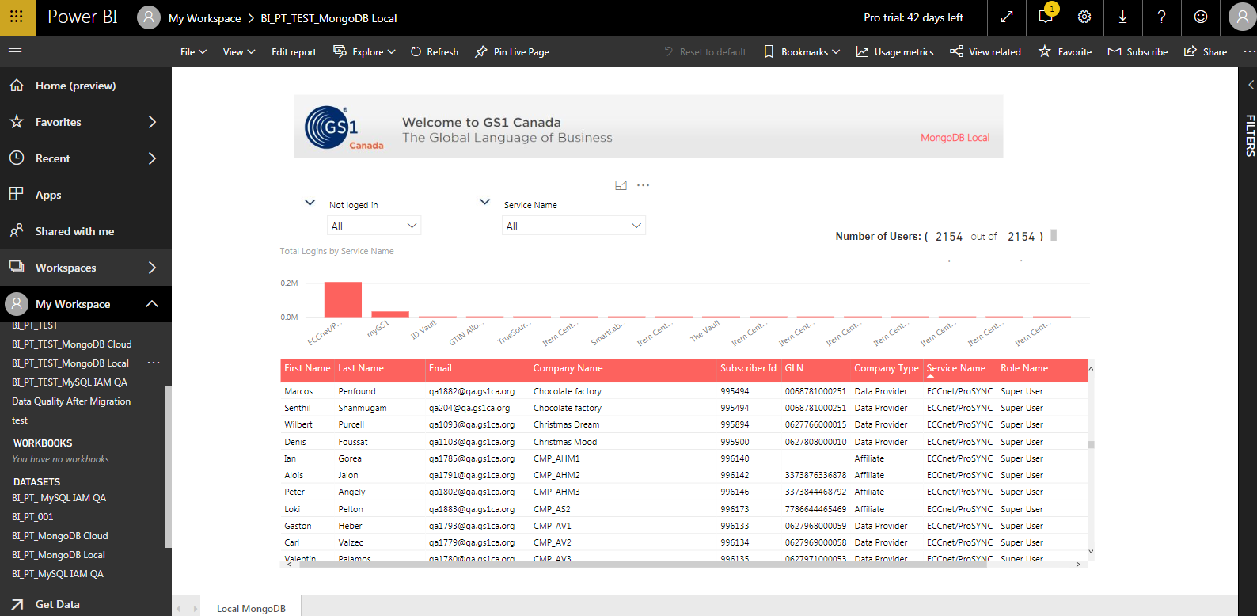
GS1 Canada D/W Prototype Demo
Define
Gather
Share
Utilize
3. Data Sharing - Office 365 Power BI Cloud
Publish Reports to Office 365 Power BI Cloud
- Share Report
with Other users
- Power BI Pro license
https://app.powerbi.com/groups/me/reports/2eba49f4-c9e5-4de2-87a2-725ad2812458/ReportSection9fa765df56b35053006e

Slide 13
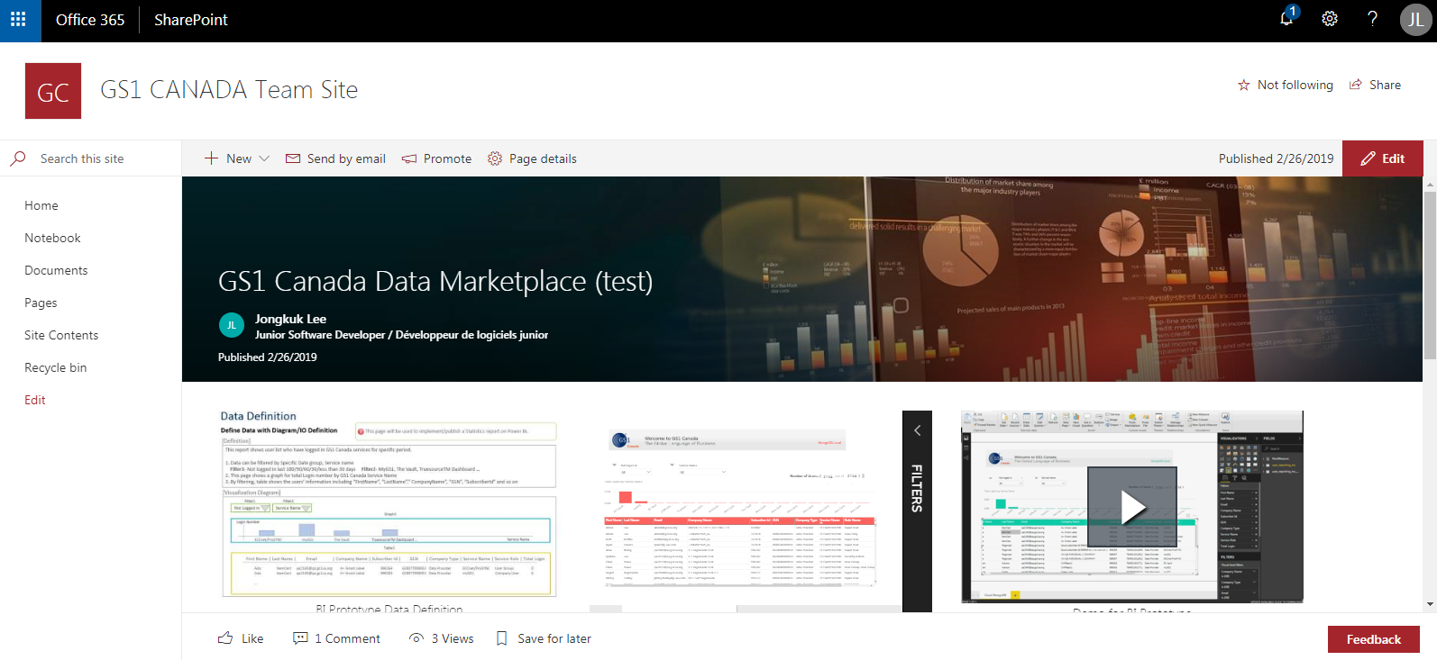
GS1 Canada D/W Prototype Demo
Define
Gather
Share
Utilize
3. Data Sharing - Office 365 SharePoint
Share Reports to Office 365 SharePoint
- Share Web page
with Other users
https://gs1ca.sharepoint.com/SitePages/BI-Prototype-Test-with-Power-BI-Cloud.aspx

Slide 14
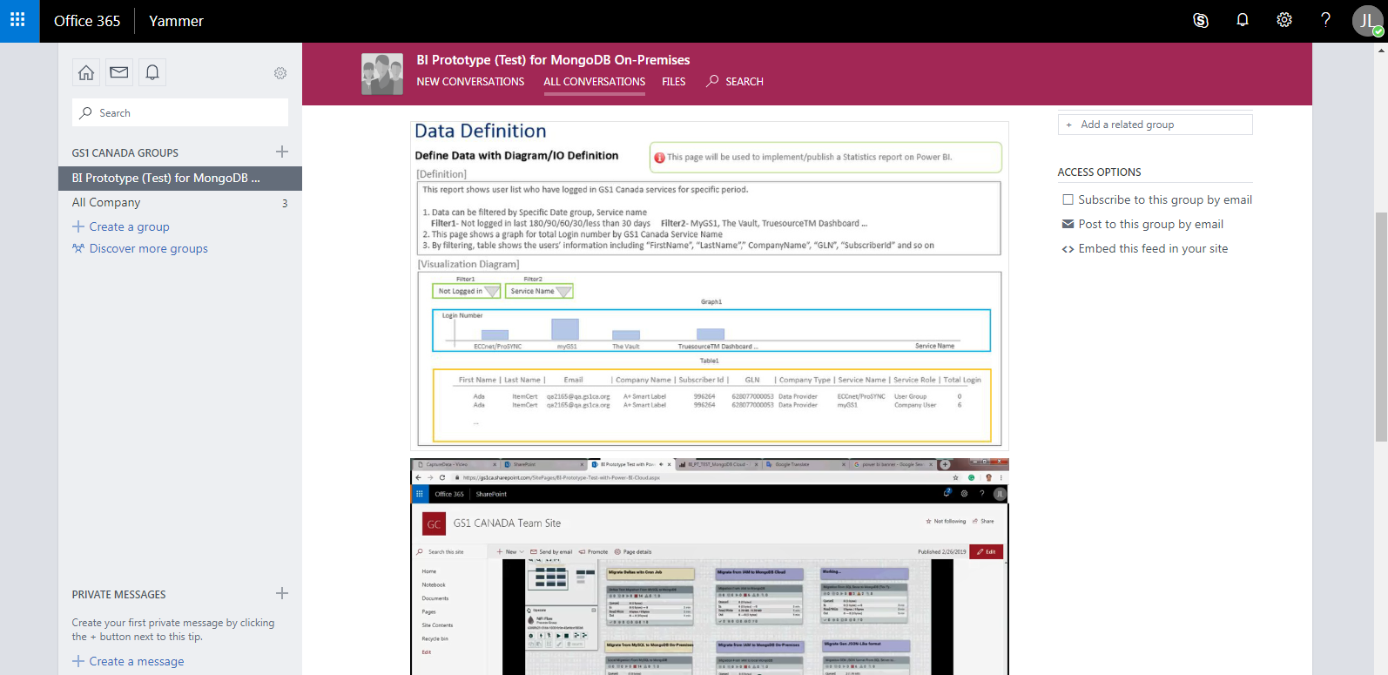
GS1 Canada D/W Prototype Demo
Define
Gather
Share
Utilize
3. Data Sharing - Office 365 Yammer
Share Reports to Office 365 Yammer
https://www.yammer.com/gs1ca.org/#/threads/inGroup?type=in_group&feedId=17459159&view=all

Slide 15

GS1 Canada D/W Prototype Demo
Define
Gather
Share
Utilize
4. Data Utilizing
GS1 Canada Data Marketplace
Distribute to end-users
Table 1
Chart 1
Matrix 1
Reuse
Composite
Finance
Chart 1
Supply
Table 2
Chart 2
Matrix 2
Re-Distribute
Matrix 1
Table N
Chart N
Matrix N
Table 2
Marketing
Sales
With Internal Users (Office 365 SharePoint/PowerApps/Yammer/Outlook)
With External Users (Social Media/Outlook/Web/Mobile)

Slide 16
GS1 Canada D/W Prototype Demo
Demo
1. Demo Scenario and Run Required Components
https://gs1ca.sharepoint.com/portals/hub/_layouts/15/PointPublishing.aspx?app=video&p=p&chid=1baba4ce-83a9-4d99-ad67-d8e582819c69&vid=200212db-0dbf-438c-bc88-9462bad43d0a
2. Migrate Data and Build/Publish Power BI Report
https://gs1ca.sharepoint.com/portals/hub/_layouts/15/PointPublishing.aspx?app=video&p=p&chid=1baba4ce-83a9-4d99-ad67-d8e582819c69&vid=4193ffbe-2125-48ec-8833-4be590eb410f
3. Share Data with Office 365 SharePoint
https://gs1ca.sharepoint.com/portals/hub/_layouts/15/PointPublishing.aspx?app=video&p=p&chid=1baba4ce-83a9-4d99-ad67-d8e582819c69&vid=aafacd7b-20d1-41ec-9fba-c8846092e437
4. Share Data with Office 365 Yammer
https://gs1ca.sharepoint.com/portals/hub/_layouts/15/PointPublishing.aspx?app=video&p=p&chid=1baba4ce-83a9-4d99-ad67-d8e582819c69&vid=86ad536b-968a-4ba2-a742-6d3170f00f28

Slide 17
GS1 Canada D/W Prototype Demo
Apache NiFi can handle all data format including JSON, XML, CSV, Avro, images and video, and several other formats.
When we insert data to MongoDB with Apache NiFi, it registers the format to "Schema Registry" with Apache Avro format before migrating.
"Avro" is a remote procedure call and data serialization framework, provided by Apache project.
Work-process:
Schema Design --> Mapping Fields --> Register JSON format with "Avro format" --> map/assign the received data to the registered "Avro format" inside “putMongoRecord” component (that is why we need a fixed schema)
To Solve:
1. Define the fixed schema structure for data being migrated
Downside: must use only fixed data schema
2. Call "mongoimport" command with "executeProcessor" component in Apache NiFi
Downside: calls system command
3. Create "Custom Component" with Java
Downside: needs knowledge, time, and distributes it to other users.

